Slide 1
CMS Delivery SOLUTION In Django FRAMEWORK
Bengaluru Subham Singh 09-11-2018
(singhsubham510@gmail.com)

Slide 2
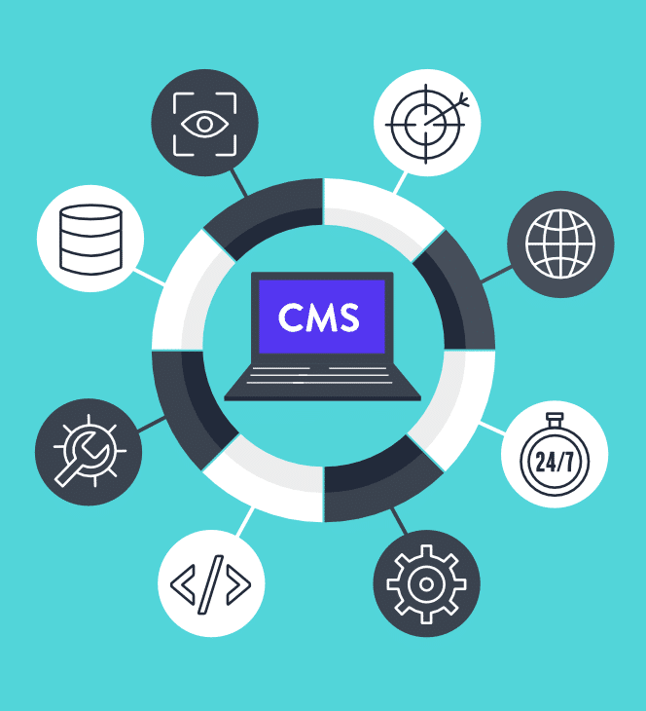
CONTENT MANAGEMENT Software
What is Content MANAGEMENT SOFTWARE ?
According to Wikipedia,
A content management system (CMS) manages the creation and modification of digital content. It typically supports multiple users in a collaborative environment.
CMS features vary widely.
Most CMSs include
Web-based publishing,
format management,
history editing and version control,
indexing,
search, and retrieval.

Slide 3
CONTENT MANAGEMENT Software
Types of Content MANAGEMENT SOFTWARE
Web Content Management System (WCMS)
Digital Asset Management System (DAM)
Document Management System (DMS)
Enterprise Content Management System (ECM)
Component Content Management System (CCMS)

Slide 4
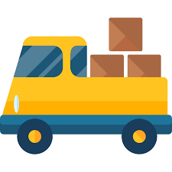
CONTENT MANAGEMENT SYSTEM in Delivery Solutions
Automate the delivery CMS system which can make smart decision that which delivery point it should reach first for feasible ways by taking list of address from all the nearest delivery points.

Slide 5
What does it consist of ?
ADMIN PANAL- INTERACT WITH ADMIN
DELIVERY BOY PANAL –INTERACT WITH DELIVERY BOY
END USER VIEW – INTERACT WITH THE OUR CUSTOMERS

Slide 6
Why I WANT to Choose Django Framework
Ridiculously fast.
Django was designed to help developers take applications from concept to completion as quickly as possible.
Full Loaded.
Django includes dozens of extras you can use to handle common Web development tasks. Django takes care of user authentication, content administration, site maps, RSS feeds, and many more tasks — right out of the box.
Reassuringly secure.
Its user authentication system provides a secure way to manage user accounts and passwords.
Exceedingly scalable.
Some of the busiest sites on the planet use Django’s ability to quickly and flexibly scale to meet the heaviest traffic demands.

Slide 7
Features Needed to add in it…
Admin PANEL
All CRUD OPERATIONS
Insight of in which area the delivery is more(business insight)
Set filters of regions to which the organization can deliver the product
Assign the delivery product to different delivery agents of different regions with just one click
Intelligently takes decision for the specific region which delivery to process first and accordingly instruct the delivery agents.
DELIVERY AGENT PANEL
Check the instruction update from Admin to process which delivery to process first and faster.
Customer PANEL
Customer interaction for registration and login.
Order for delivery
Track order detail
Feedback interaction
Chat Bot (future scope)

Slide 8
Have you noticed a term used in ABOVE SLIDE…
Intelligently takes decision
Regional Insights

Slide 9
Let’s Clear it Out…
Regional Insights
Which area the delivery is more get the insight
Intelligently takes decision
Let’s Delivery boy is at point ‘P’
Let’s there exist three delivery points as ‘D1’ ‘D2’ ‘D3’.
Here lets distance between P to D1 = 5 units
lets distance between P to D2 = 2 units
lets distance between P to D3 = 12 units
Then our system should get the decision that as from P to D2 distance is less and less traffic according to google map so delivery boy can reach there more quick and complete the delivery
SOMETHING
SOMETHING
SOMETHING
SOMETHING

Slide 10
Working on Regional Insights Part
HTML5
CSS
JavaScript
In Python use of Pandas, Numpy and Matplotlib
PostgreSQL
Of course Django Framework
For working on regional insights part we need these skills to acquire : -

Slide 11
Map Views we can do with Django Framework…

Slide 12
Abstract of the project:
The project abstracts the concept of self-driving cars to autonomous agents that are given coordinates to drive to and commands to stop or drive.

Slide 13
An Autonomous AGENT
According to a paper entitled “A Taxonomy for Autonomous Agents” ,
an autonomous agent is a “system situated within and a part of an environment that senses that environment and acts on it, over time, in pursuit of its own agenda and so as to effect what it senses in the future.”
An agent is goal driven and fundamentally, reacts to stimuli without the interference of the owner.

Slide 14
comparing above definition with AUTONOMOUS COURRIER Vehicle
An autonomous courier vehicle can be characterized by this definition. Its environment is the road network – represented as a graph of nodes and vertices.
Its stimuli are incoming, unallocated courier jobs, which are broadcast over the air to all agents, as well as (potentially) the positions and status of other agents.
Its overarching goal is to allocate themselves to, pick up and deliver as many packages as possible, whilst conforming to each associated deadline.
There are also secondary goals, such as refueling whenever possible and minimizing fuel consumption in various ways.
These goals will be programmed in to all agents in the hopes that the multi-agent system, as a whole, will satisfy the owner’s goal: profit.

Slide 15
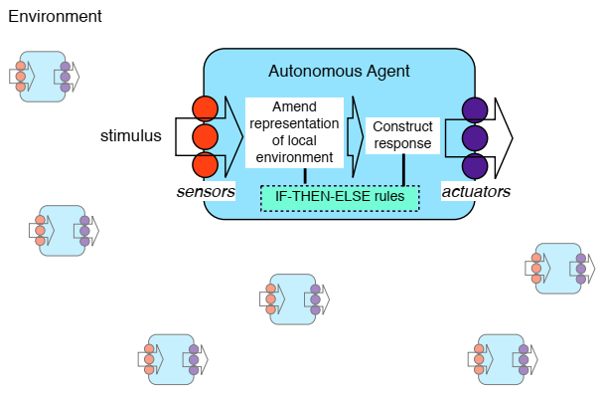
Multi agent system in most general form

Slide 16
Architecture of real time tracking module
Django Framework (REST)
Use the framework for the REST development
Node.js
Use socket.io for maintaining continuous connection between device and Internet.
Mango DB
For storing the gps coordinate of the trip and later store the same in sql db.
SQL Database
Mainly used for storing coordinates points into actual database.
Ionic Framework
Develop web based mobile application using this Ionic Framework.

Slide 17
Thank You

